Slide 1

CLTV Prediction

Slide 2
Problem Statement
VahanBima is one of the leading insurance companies in India. It provides motor vehicle insurances at best prices with 24/7 claim settlement. It offers different types of policies for both personal and commercial vehicles. It has established its brand across different regions in India.
Around 90% of the businesses today use personalized services. The company wants to launch different personalized experience programs for customers of VahanBima. The personalized experience can be dedicated resources for claim settlement, different kinds of services at doorstep, etc. In order to do so, they would like to segment the customers into different tiers based on their customer lifetime value (CLTV).
In order to do it, they would like to predict the customer lifetime value based on the activity and interaction of the customer with the platform. So, as a part of this challenge, your task at hand is to build a high performance and interpretable machine learning model to predict the CLTV based on the user and policy data.

Slide 3
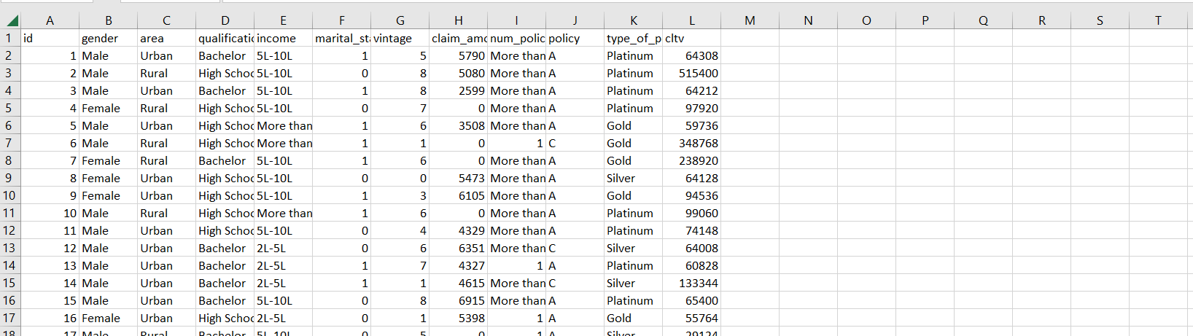
DATA SHARED
Task: Regression
Training Set: 89393 rows, 11 predictors
Test Set: 59596 rows, 11 predictors
Predictors:
Id, gender,area,qualification,income,marital_status,vintage,claim_amount,num_policy,poicy,type_of_policy
EDA:
Some predictors are categorical and others are numerical.
No Missing Values
No Duplicate rows
Id column is unique so it can be removed.
Target Variable is continuous, and it is right skewed.

Slide 4
Approach
• EDA (check null values, check distributions and skewness, checked unique values), there was skewness in two numerical columns.
• Feature Engineering- One Hot Encoding(Gender, Area, Qualification, income, num_policy,policy), Label Encoder(type_of_policy, Income).
• Model Training- Train test split(0.85) Trained model with Random Forest, Gradient Boost, Adaboost, Catboost, Lasso, Ridge, Knn, SVR, Deep Learning Also some AUTOML-H2O, Pycaret, EvalML.
• After that I experimented various type of pre-processing-
• Transformations – Quantile transformation and also target transformation but did not perform well.
• Feature Engineering – I tried transforming numerical columns by grouping various categorical columns.
• Hyperparameter tunning – I tunned hyper parameters with the help of GridsearchCV.
•Pycaret-Gradient Boosting Regressor performed well with R2-0.1615, H2O-Stacked Ensemble Model performed well with R2-0.174.

Slide 5
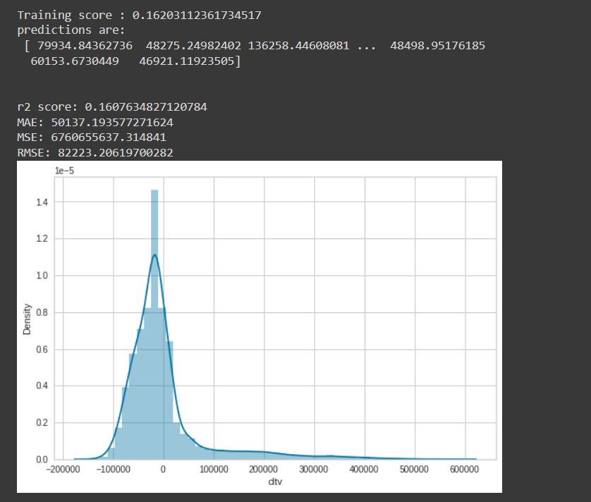
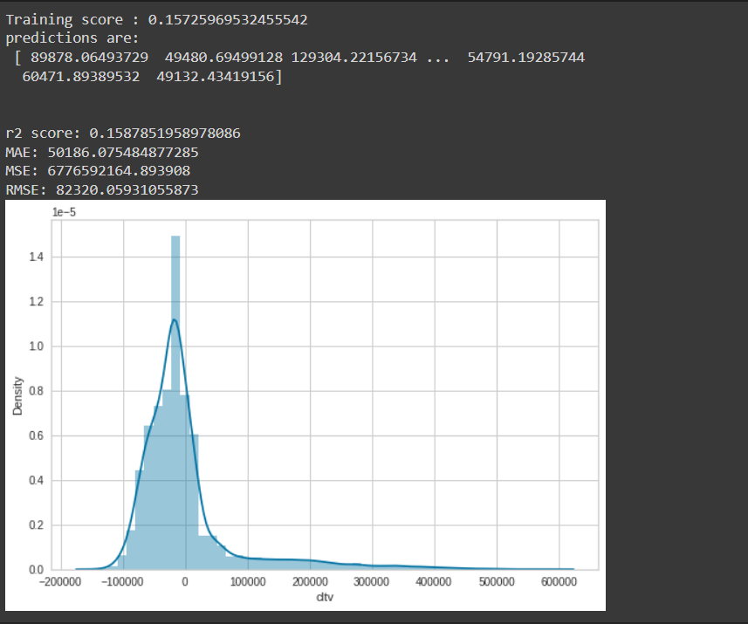
Model Performance
Gradient Boost
Random Forest

Slide 6
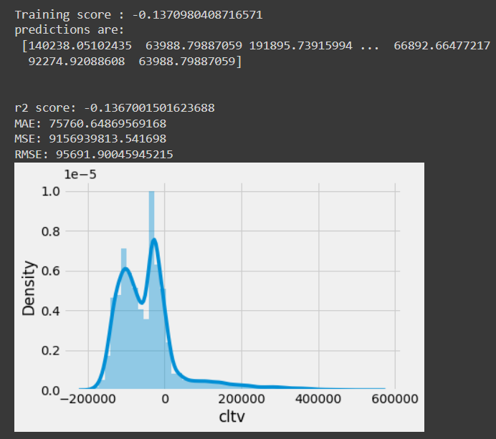
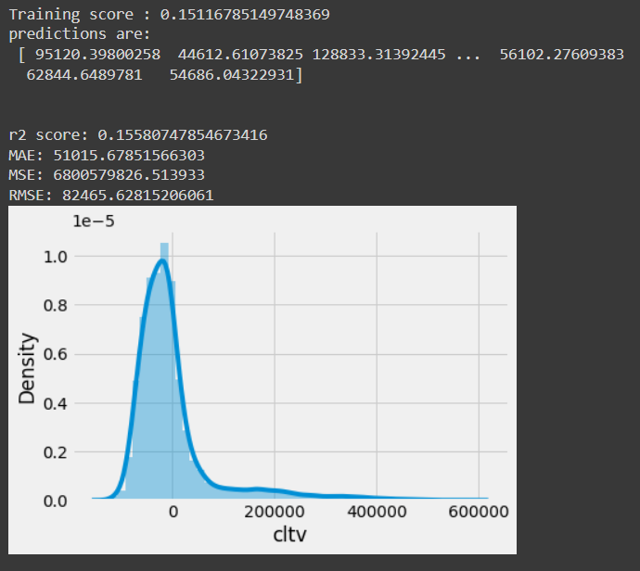
Model Performance
Ada Boost
Lasso Regression

Slide 7
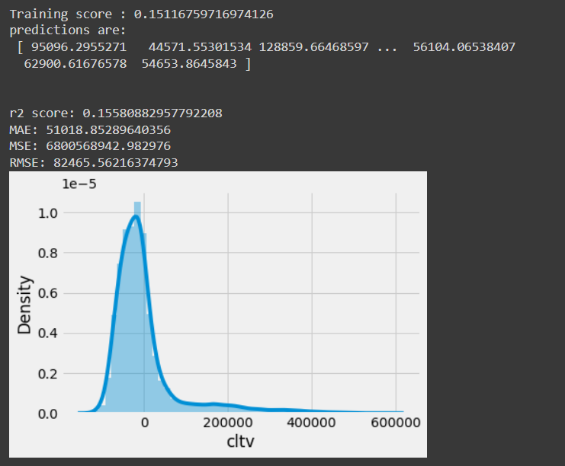
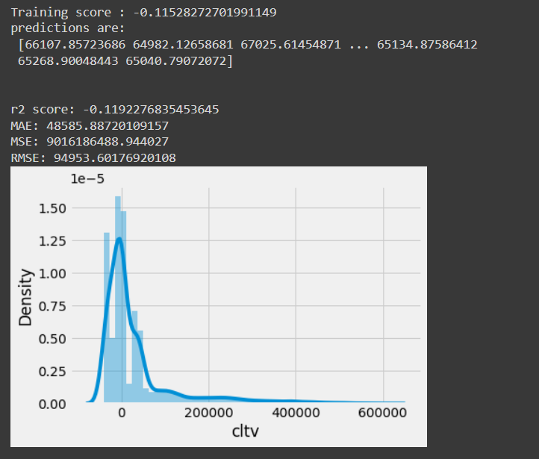
Model Performance
Ridge Regression
SVR

Slide 8
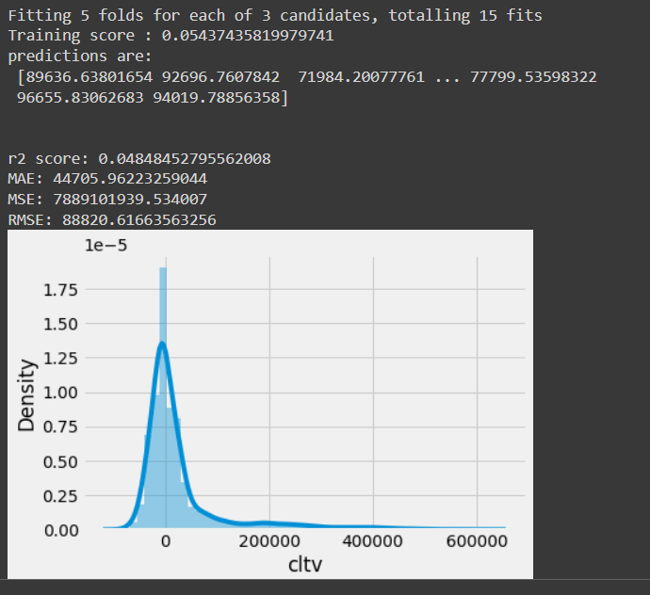
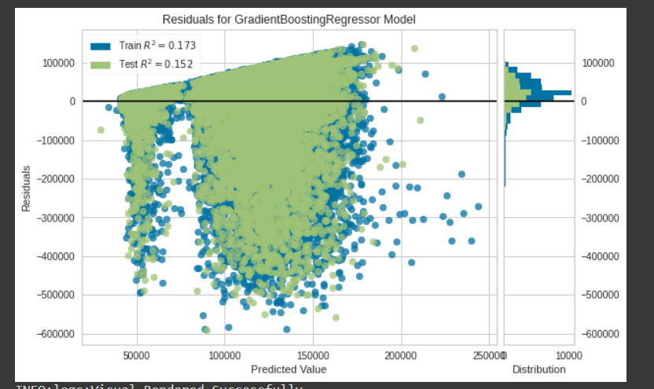
Model Performance
Gradient Boost with Quantile Transformer
Pycaret Gradient Boost

Slide 9
Model Comparison
Model | Training r2_score | Test r2_score | MAE | MSE | RMSE
Gradient Boost | 0.16 | 0.16 | 50137.19 | 6760655637.31 | 82223.20
Ridge Regression | 0.15 | 0.15 | 51018.85 | 6800568942.98 | 82465.56
Lasso Regression | 0.15 | 0.15 | 51015.67 | 6800579826.513 | 82465.62
Random Forest | 0.15 | 0.15 | 50186.07 | 6776592164.89 | 82320.0593105
H2O Stacked Ensemble | 0.17 | 0.16 | 50422.04 | 6891120356.52 | 83012.77
Pycaret Gradient Boost | 0.15 | 0.155 | 49555.00 | 6.508333e+09 | 80674.2404
AdaBoost | -0.13 | -0.13 | 75760.64 | 9156939813.54 | 95691.90
XGBoost | 0.06 | 0.04 | 44725.86 | 7882789955.2 | 88785.07

